Slide 1
Customer Segmentation and Intelligent
Mobile Recommendation System
Minor Project Mid-Term Presentation
Submitted By:
Aayush Chhuka [NCE080BCT002]
Hom Raj Bhandari [NCE080BCT016]
Sudip Kumar Tamang [NCE080BCT042]
Suresh Khadka [NCE080BCT046]
Presented To: Department of Electronics & Computer Engineering, NCE, Lalitpur
Date: July, 2026

Slide 2
1. Introduction
Background:
Booming smartphone market, overwhelming customer choices.
Dozens of brands launch new models constantly; customers struggle to compare specs and budget, while retailers struggle to match the right phone to the right buyer.
Objective:
Segment customers, recommend phones intelligently using ML.
Combine phone specifications with customer behavior to generate personalized, explainable phone recommendations for each buyer segment.

Slide 3
1. Introduction
Methods / Performance:
XGBoost regression, K-Means clustering, SHAP.
XGBoost predicts phone performance scores; K-Means groups customers; SHAP explains results. Achieved a cross-validated R² of 0.85 and MAE of 0.179.
Scope:
GSMArena specs, AnTuTu scores, full web app.
Covers data collection, preprocessing, ML modelling, and a role-based React + Node web application for customers, sales staff, and admins.

Slide 4
2. Problem Statement
Wide range of prices, brands, and specifications makes phone selection difficult for customers.
Basic demographic information alone cannot capture what customers actually value in a phone.
Retailers struggle to group customers meaningfully to guide recommendations and marketing.
No existing system connects customer segmentation directly to smartphone recommendations.

Slide 5
3. Aim and Objectives
Aim: To develop an intelligent mobile recommendation system using machine learning based customer segmentation.
Following are the objectives:
To collect and preprocess mobile phone data from GSMArena and AnTuTu benchmark through web scraping.
To develop a secure web application with user authentication and database management.
To build a machine learning model for customer segmentation.
To evaluate the performance and accuracy of the proposed system.

Slide 6
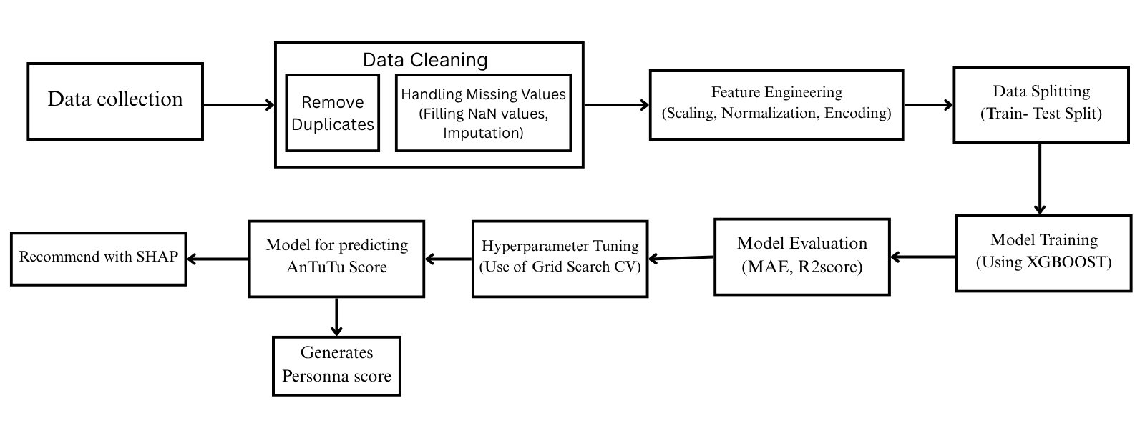
4. Methodology: System Block Diagram
End-to-end pipeline: raw data is cleaned, engineered into features, split, and used to train an XGBoost regressor, then evaluated and paired with SHAP for explainable recommendations.

Slide 7
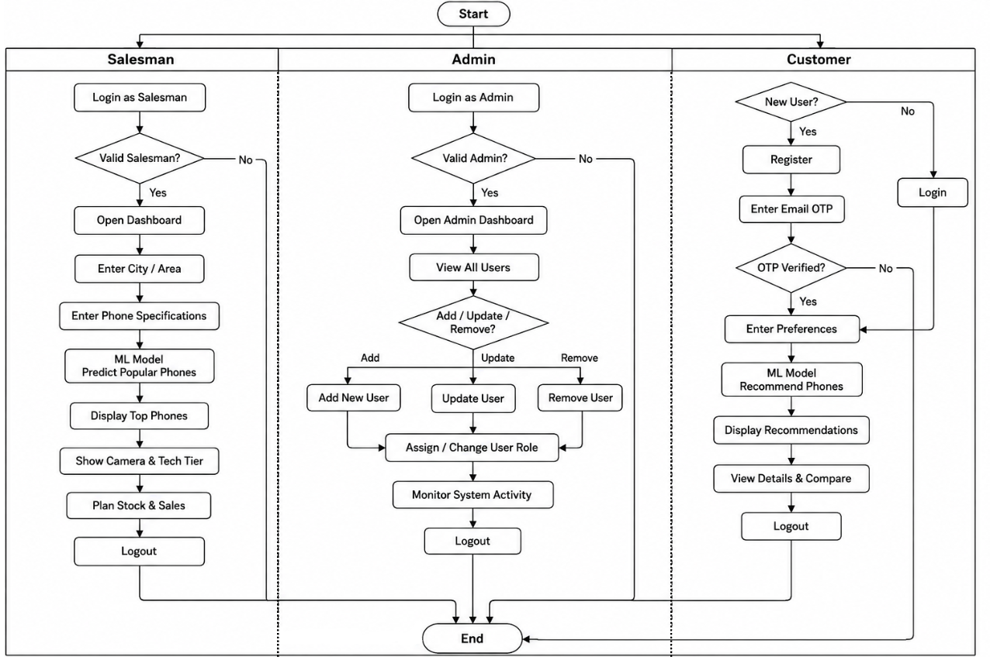
4. Methodology: System Flowchart
Three user lanes:
Admin manages users and monitors activity.
Salesman gets ML-suggested phones to stock
Customer registers, sets preferences, and views recommendation.

Slide 8
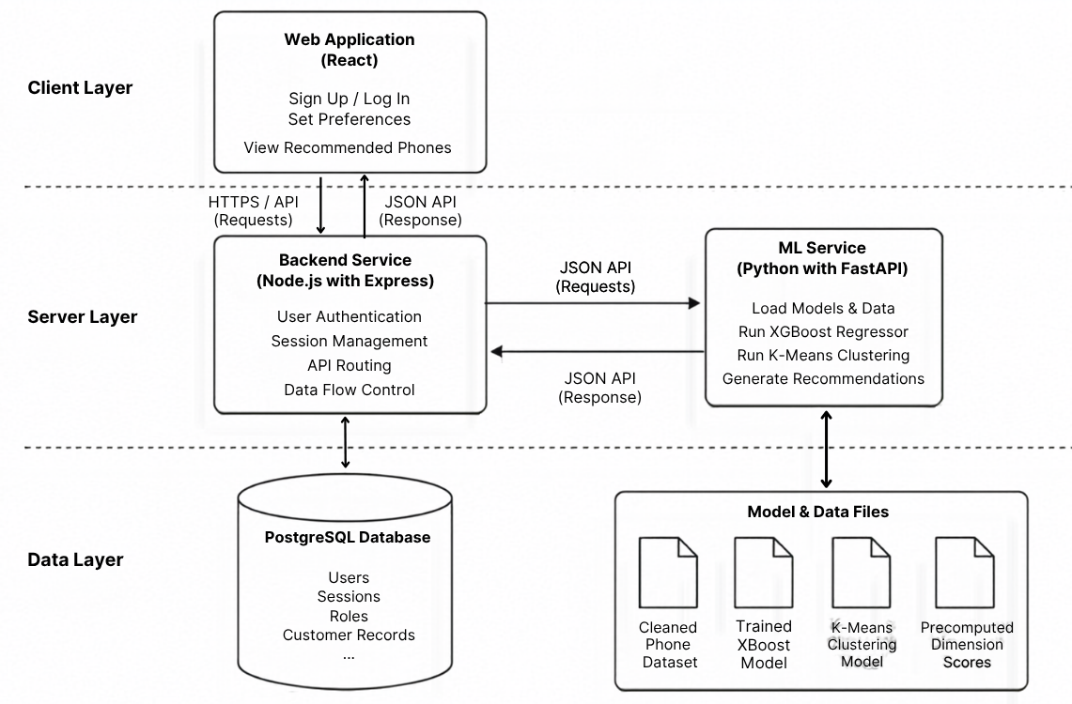
4. Methodology: System Architecture
Architecture:
Frontend: React Web Application
Backend: Node.js + Express
ML Service: FastAPI (Python)
Database: PostgreSQL
Models: XGBoost and K-Means
Output:- Personalized Phone Recommendation

Slide 9
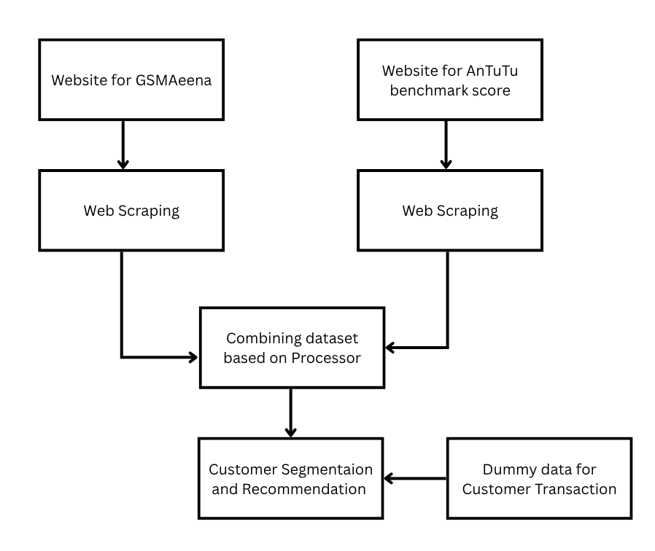
4. Methodology: Data Collection & Integration
GSMArena Specifications: 8,500+ phones scraped in batches, ~150 engineered features per device.
AnTuTu Benchmark Scores: merged on cleaned model ID; only measured scores used to train the model.
Customer Transactions: Dummy dataset to be created
Combined Dataset: feeds customer segmentation and the personalized recommendation engine.

Slide 10
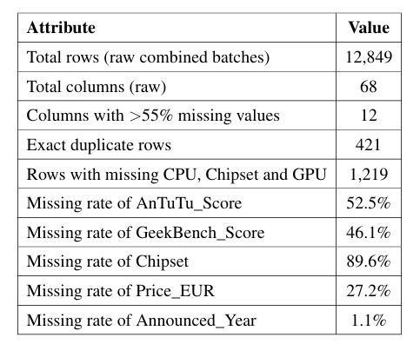
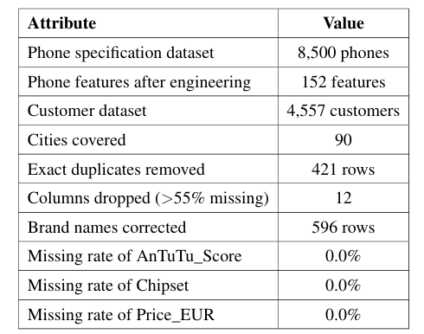
5. Task Accomplished: Data Collection & Preparation
Key steps completed:
Merged batches and removed duplicates;
parsed CPU/chipset/GPU text into structured features;
applied three-level median imputation with missing-value flags;
aggregated transactions to customer-level features.
Table: Dataset before processing
Table: Dataset after processing

Slide 11
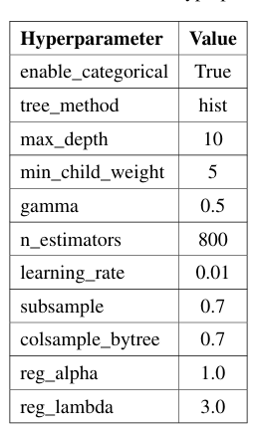
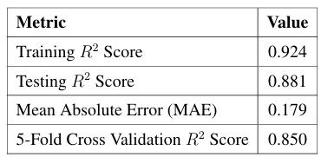
5. Task Accomplished: Machine Learning Results
Table: Performance of XGBoost Model
Table: XGBoost Hyperparameters

Slide 12
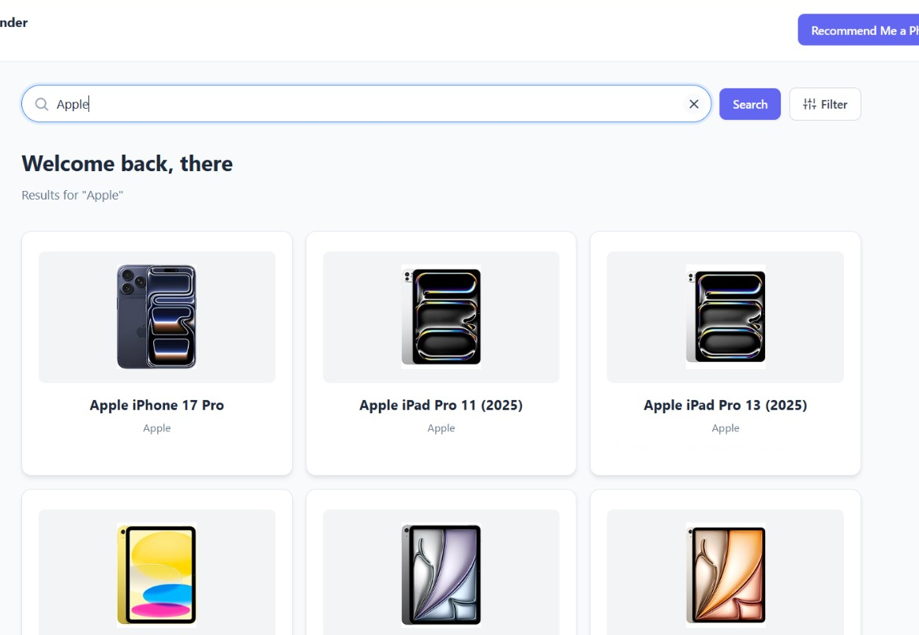
5. Task Accomplished: Web Application Development
Completed Pages:
User Login (Role Based)
Registration with OTP Verification
Password Reset
User Dashboard
Backend: Node.Js, Express,js, PostgresSQL, PrismaORM
Authentication: Registration, Login, OTP verification, Session Management

Slide 13
6. Task Remaining
Remaining tasks before final submission:
Create a realistic dummy customer dataset.
Apply K-Means clustering and select the best number of clusters.
Enhance dashboards for all three user roles.
Integrate and deploy the complete system.

